Slide 1
PROJECT PRESENTATION • FDA-V2
File Data Analyzer System
Automated Exploratory Data Analysis and Interactive Web Analytics Dashboard
Python
Streamlit
Pandas
OpenPyXL

Slide 2
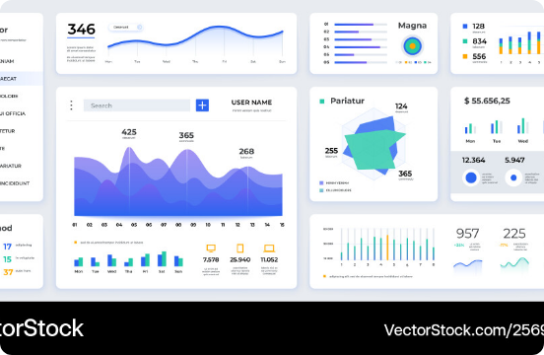
EXECUTIVE SUMMARY
Project Overview & Mission
Zero-Code Data Exploration
Converts raw CSV and Excel files into instant visual web dashboards without requiring programming knowledge.
Automated Analytics Pipeline
Handles missing value cleaning, statistical summary generation, and interactive charts automatically.
0
100%
Coding Required
Automated Pipelines

Slide 3
ARCHITECTURE & DEPS
Core Technology Stack
Streamlit 1.30+
Pandas 2.0+
NumPy 1.24+
Interactive Web Dashboard UI
High-Performance Data Processing
Vectorized Numerical Math
Matplotlib 3.8+
Seaborn 0.13+
OpenPyXL 3.1+
Base Plot Engine
Statistical Charting Library
Excel File Engine

Slide 4
SYSTEM PIPELINE
Modular Backend Structure
STEP 01
STEP 02
STEP 03
STEP 04
STEP 05
data_loader.py
data_cleaner.py
statistics.py
visualizations.py
insights.py
CSV & Excel File Ingestion
Missing Value Imputation
Correlation Matrix Analysis
Seaborn Plot Generation
Automated Text Summaries

Slide 5



SYSTEM CAPABILITIES
Core Feature Set
Automated Data Cleaning
Statistical Analytics
Interactive Visuals
•
Null Imputation: Automatic missing value fill
•
Descriptive Metrics: Mean, median, std-dev
•
Dynamic Charts: Histograms & box plots
•
Dtype Conversion: Smart type casting
•
Distribution Rules: Skewness & kurtosis
•
Heatmaps: Color correlation matrix
•
Deduplication: Instant duplicate removal
•
Feature Matrices: Correlation scoring
•
Chart Downloads: High-res PNG export

Slide 6
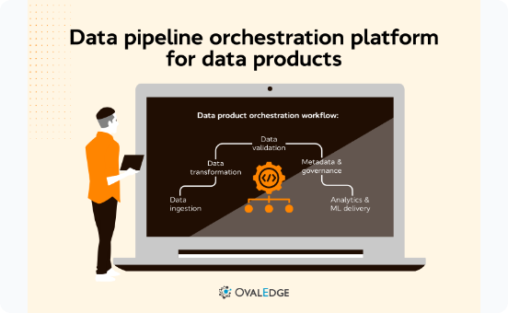
CLOUD HOUSING
Streamlit Community Cloud Deployment
GitHub CI/CD Automation
Automatic application rebuilds on every git push.
Requirements Pinning
Self-contained Python environment installation.
Public Accessibility
Instant access via custom HTTPS subdomain.

Slide 7
FDA-V2 DASHBOARD
Thank You!
Ready for questions and project discussion.
GitHub: JashuaGummalla/FileDataAnalyzer

Slide 8


Image Sources
https://cdn.vectorstock.com/i/1000v/03/50/modern-data-dashboard-ui-vector-25690350.jpg
Source: www.vectorstock.com
https://www.ovaledge.com/hubfs/Ovaledge%20Banner%20Blog%20(3).png
Source: www.ovaledge.com

